Slide 1
STUDENT MANAGEMENT SYSTEM
PYQT5
Presented by: Seemal Naeem, Umm-ul-Baneen, Laiba, Isha Imran and Muniba Khalid

Slide 2

INTRODUCTION
Student Management System is a software which is helpful for school management. In this current system, all the activities are done manually. In this software, management can log in as a user and can add, delete, and update students. Also, there is an option to manage the fees and attendance of students. This proposed system has several advantages including a user-friendly interface, fast access to a database, look and feel environment.

Slide 3



SOFTWARES & DATABASE
The software used in this project includes:
PyCharm
Qt Designer (UI)
Excel is used as a database.

Slide 4
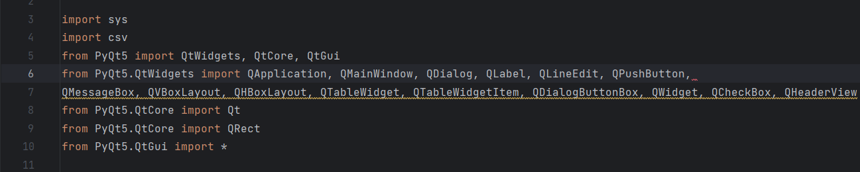
LIBRARIES
In this project, different Python libraries are used including:
sys: This library provides access to some variables used or maintained by the interpreter and to functions that interact with the interpreter.
CSV: This library provides functionality for reading and writing CSV (Comma Separated Values) files.
PyQt5: This library provides a set of Python bindings for Qt, a powerful cross-platform application framework. It is used for creating graphical user interfaces (GUIs).

Slide 5
MAIN FUNCTIONS
setupUi: Sets up the UI layout, and styles, and connects the login button to the openwindow1 function.
retranslateUi: Translates text on UI elements.
__init__ (MainWindow constructor): Initializes the main window, creates widgets, and connects button clicks to functions.

Slide 6
FLOW DIAGRAM
Login Window
Warning
No
Login Authentication
Yes
SMD Window
Add
Delete
Update
Manage Fees
Attendance
Input
Selection
Input
Input
Input
Output Table
Logout

Slide 7
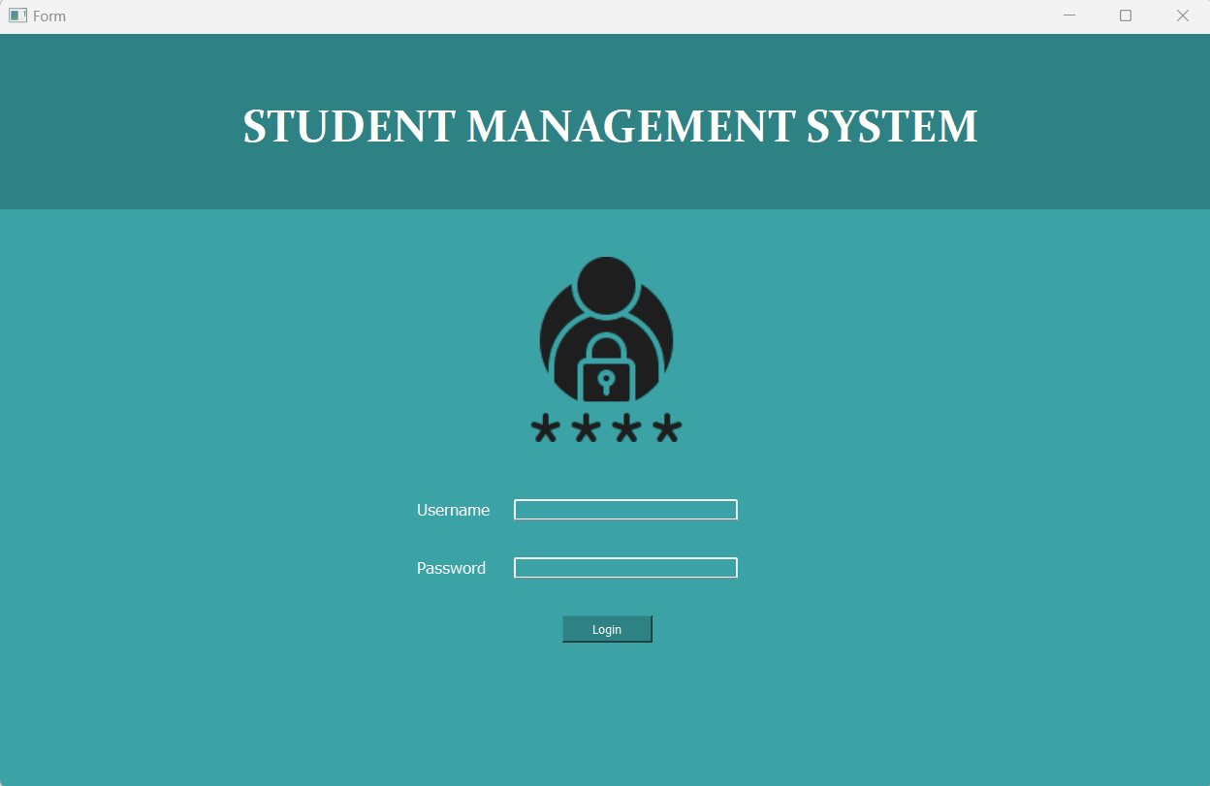
User Interface
Frame1
Label
Frame2
Image
Labels
Line Edit
Pushbutton

Slide 8
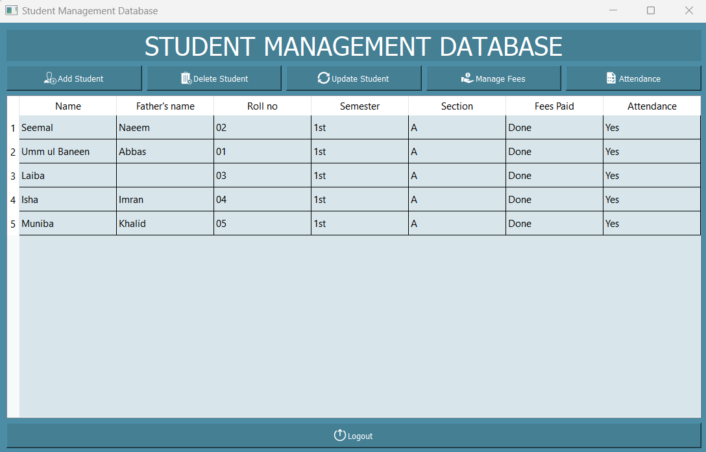
User Interface
Label
Pushbuttons
Table Widget
Pushbutton

Slide 9
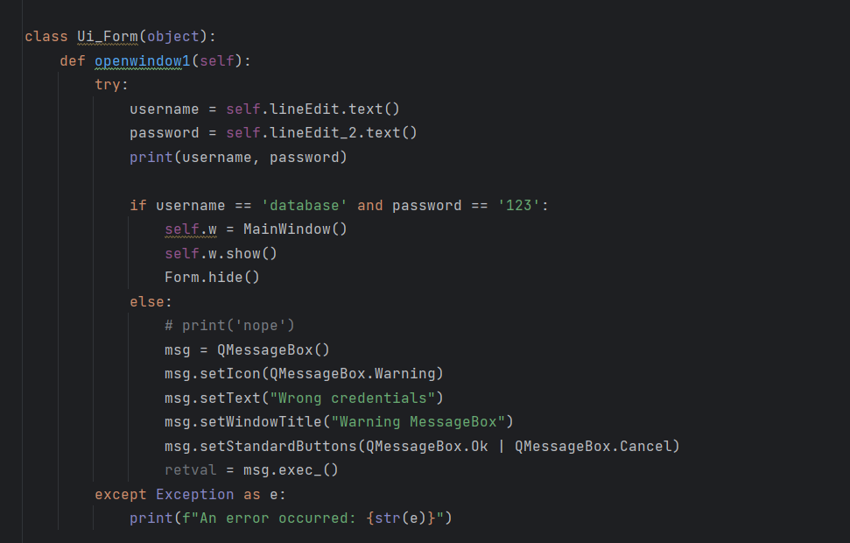
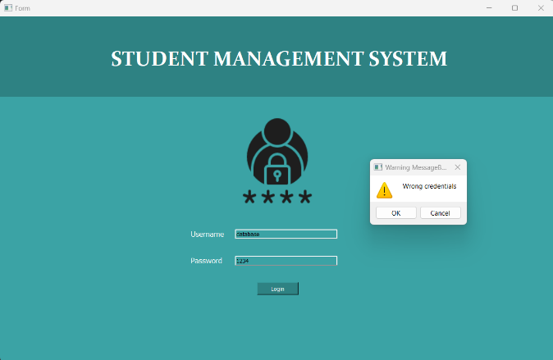
FUNCTIONS
Login
In login functionality, code captures the values entered in two line edit widgets (username and password), checks if they match a specific username and password, and based on the result, either open a new window or displays a warning message using a QMessageBox

Slide 10
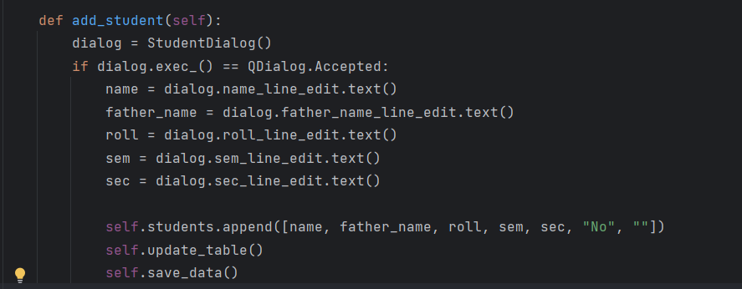
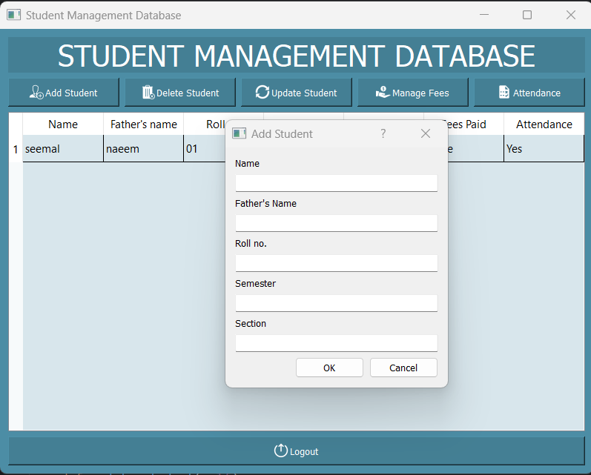
FUNCTIONS
Add
This code piece is used to add a new student's information to a list (self.students) and update a table widget to reflect the new data. It assumes that a custom dialog window (StudentDialog) is used to capture the student's information. The save_data() method is responsible for persisting the data, but its implementation is not provided here.

Slide 11
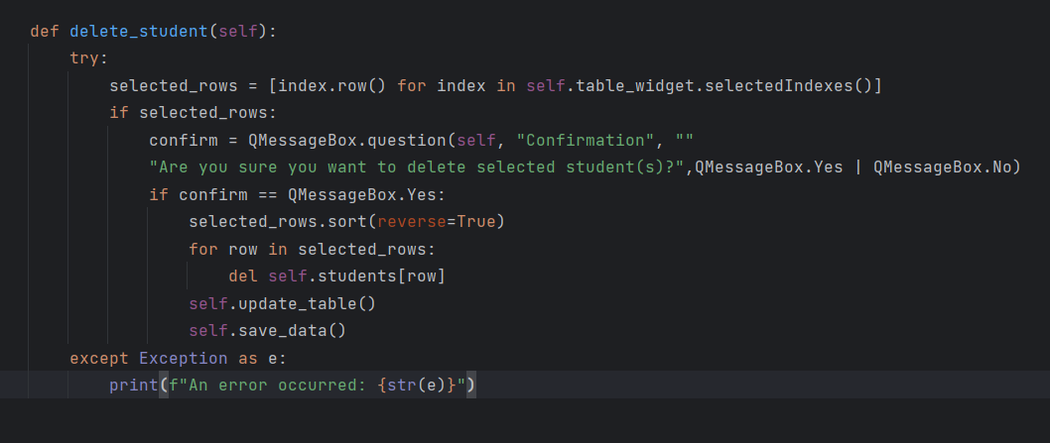
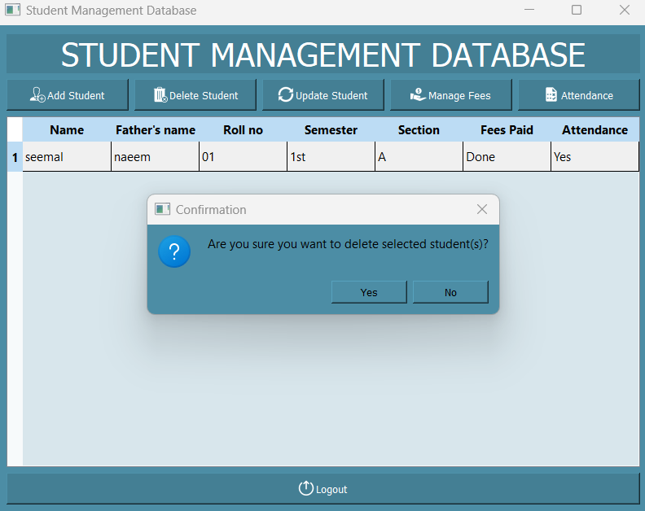
FUNCTIONS
Delete
The delete_student function deletes the selected student(s) from the self.students list based on the selected rows in the table_widget. It asks for confirmation from the user before performing the deletion. After deleting the selected student(s), it updates the table widget and saves the updated data. If any exceptions occur, they will be caught, and an error message is printed.

Slide 12
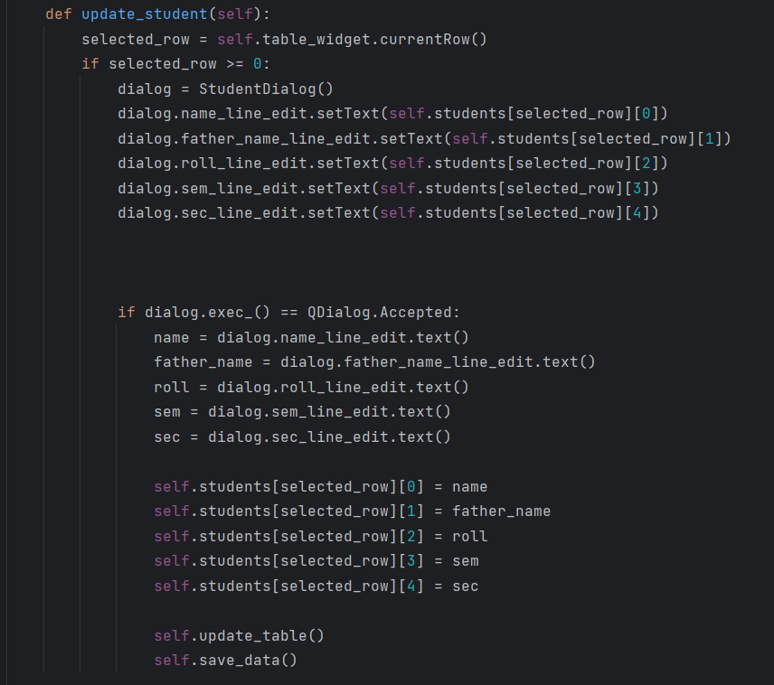
FUNCTIONS
Update
This code snippet is used to update a selected student's information in the students list depending on modifications made in a custom dialogue window (StudentDialog). The update_table() function is in charge of updating the table widget, and the save_data() method is in charge of storing the modified data.

Slide 13
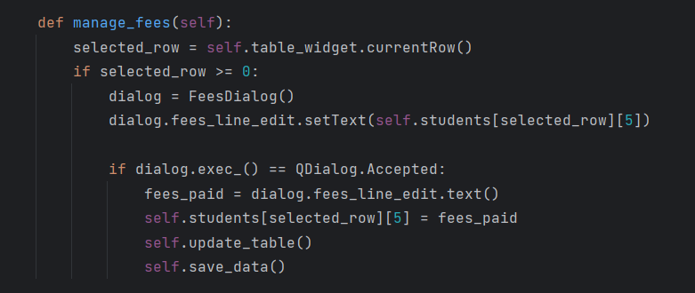
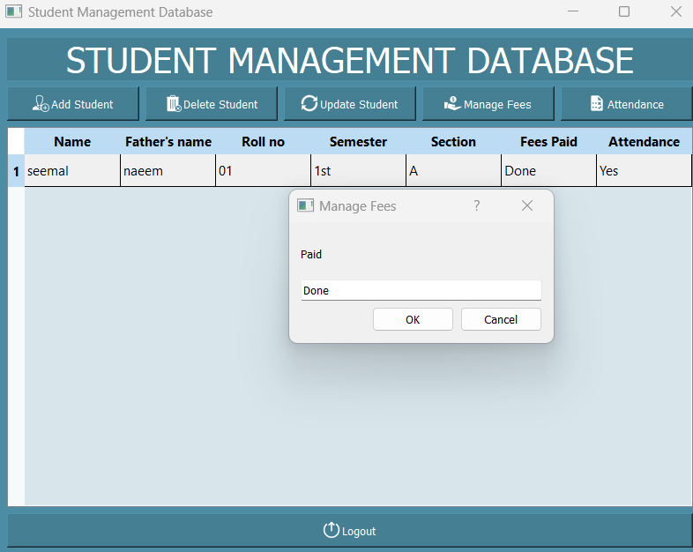
FUNCTIONS
Fees
This code snippet is used to handle a specific student's fees. It displays the current fee information in a custom dialogue window (FeesDialog) and allows the user to edit it. Following the acceptance of the modifications, the code updates the students list, and the table widget, and stores the updated data.

Slide 14
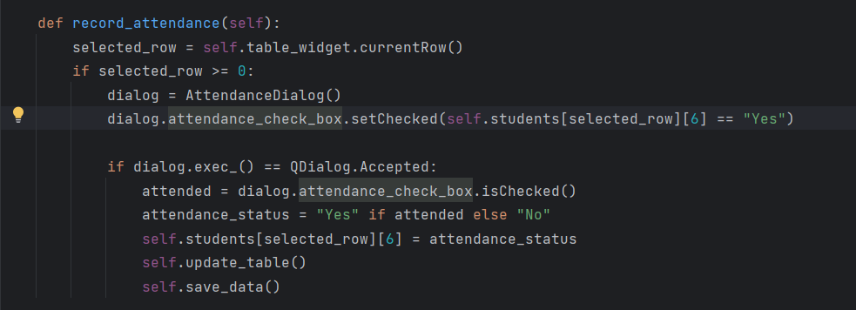
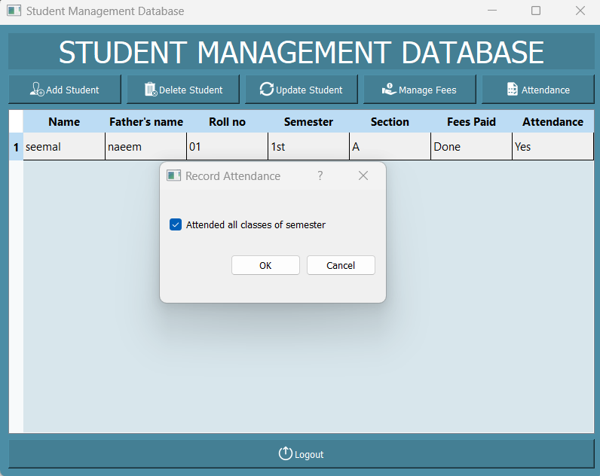
FUNCTIONS
Attendance
This code snippet is used to track a specific student's attendance. It displays the current attendance status in a custom dialogue window (AttendanceDialog) and allows the user to adjust it with a checkbox. Following the acceptance of the modifications, the code updates the students list, and the table widget, and stores the updated data.

Slide 15
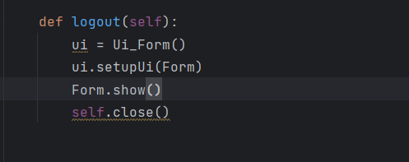
FUNCTIONS
Logout
The logout function is in charge of configuring and displaying the main form (after the user logs out), using the Ui_Form class and its setupUi method to configure the UI components before displaying the form.

Slide 16
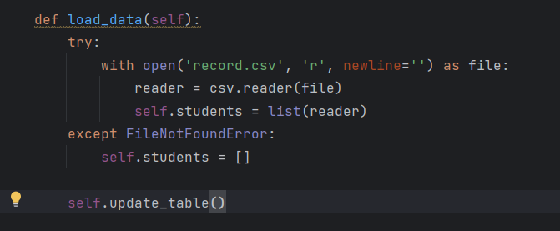
FUNCTIONS
Load data
The load_data method tries to open and read the "record.csv" CSV file. If the file is located, the data is read using a CSV reader and stored in the students property. If the file cannot be retrieved, pupils are allocated to an empty list. Finally, the update_table function is used to update the GUI table with the supplied data.

Slide 17
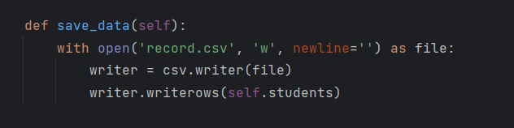
FUNCTIONS
Save data
The save_data function opens the "record.csv" file in write mode, creates a CSV writer object, and then writes the data from the self.students list to the file using the writerows method. This ensures that the data is saved in CSV format and persists for future use.

Slide 18
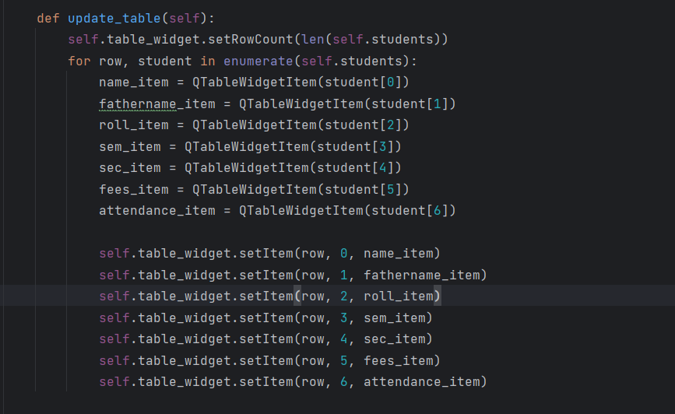
FUNCTIONS
Update data
The update_table function updates the table_widget to display the student records stored in the self.students list. It sets the number of rows in the table, creates QTableWidgetItem objects for each field of a student record, and sets these items in the appropriate cells of the table. This ensures that the table reflects the current state of the student data.

Slide 19
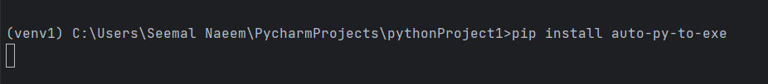
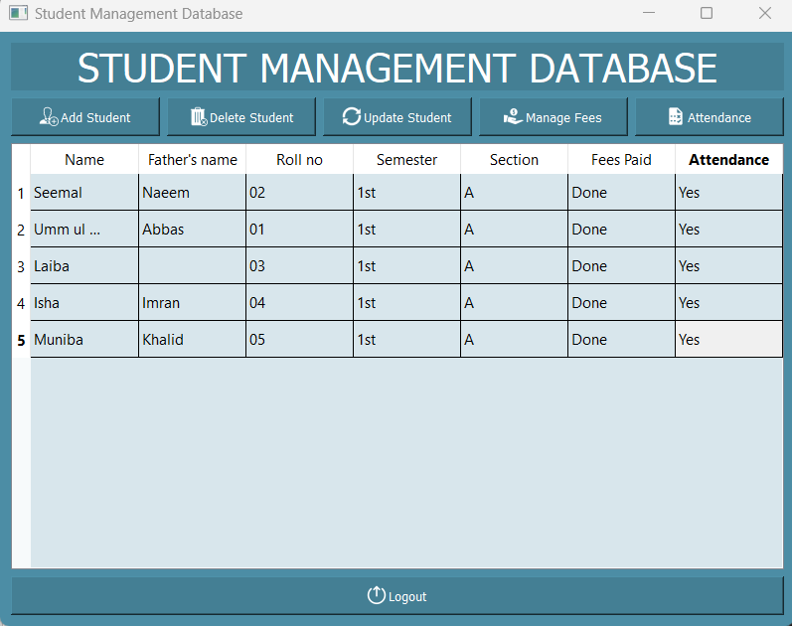
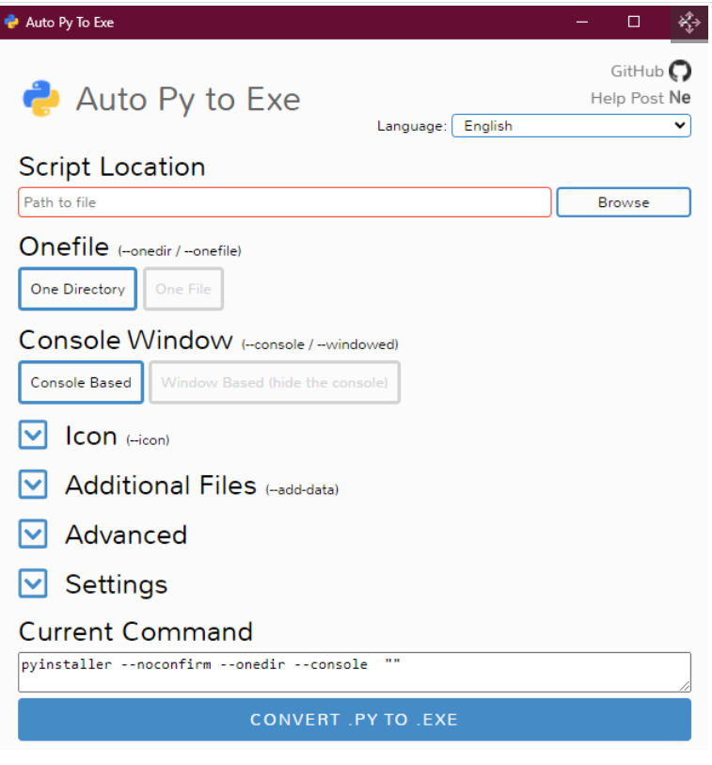
STUDENT MANAGEMENT DATABASE EXE

Slide 20
CONCLUSION
The objective of this software is to provide a framework that enables administrators to conveniently store the data of students. Several proposals are made to improve the functioning and usefulness of the Student Management System. Improving data validation, implementing search and filtering functionalities, enhancing reporting and analytics, implementing notifications and reminders, integrating with existing systems, improving the user interface, implementing data backup and recovery, providing user training and support, and gathering user feedback are some of these. These additions will provide effective data management and decision-making capabilities to school administrators, instructors, and staff.

Slide 21
THANK YOU

